Slide 1
How to create a link to Primo in an Alma Analytics report
Yoel Kortick – Senior Librarian

Slide 2

Agenda
  Introduction
  Determine the URL template
  Create the link in an analytics report
  Create a textual hyperlink for Excel

Slide 3


Introduction

Slide 4
Introduction
There are multiple ways to create a link to a specific record in Primo from within an Alma Analytics report.
In the example here we will display the actual URL to the record in Primo.
When a report is exported with the URL it can be clicked as a hyperlink and then the record in Primo will be displayed.

Slide 5

Determine the URL template

Slide 6
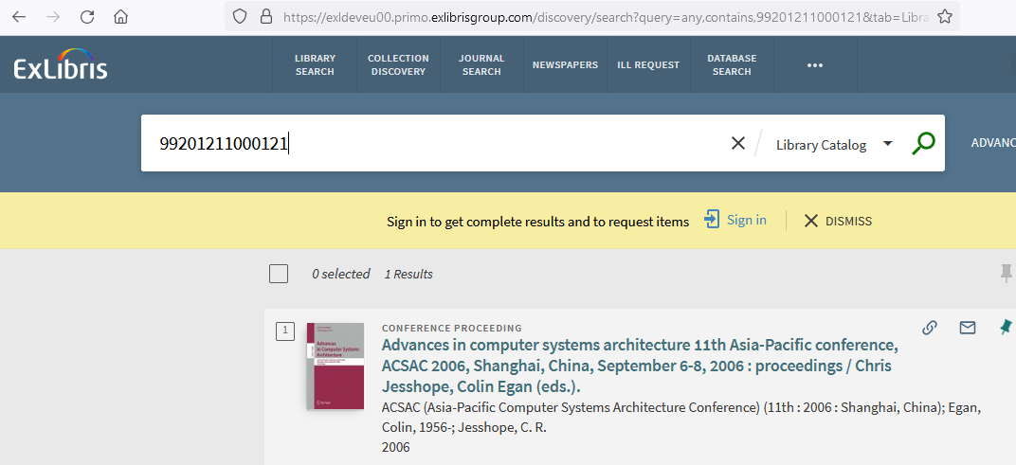
Determine the URL template
Search Primo once by MMSID and copy the URL
This is the URL template

Slide 7
Determine the URL template
This is the URL template
The MMS ID will change per record. The rest will remain the same
https://exldeveu00.primo.exlibrisgroup.com/discovery/search?query=any,contains,99201211000121&tab=LibraryCatalog&search_scope=MyInstitution&vid=EXLDEV1_INST:Alma&lang=en&offset=0

Slide 8

Create the link in an analytics report

Slide 9
Create the link in an analytics report
In order to create the link in an analytics report we will:
Make a report which includes the MMS ID
Append the text of the URL template which appears before the MMS ID to the beginning of the MMS ID
Append the text of the URL template which appears after the MMS ID to the end of the MMS ID

Slide 10
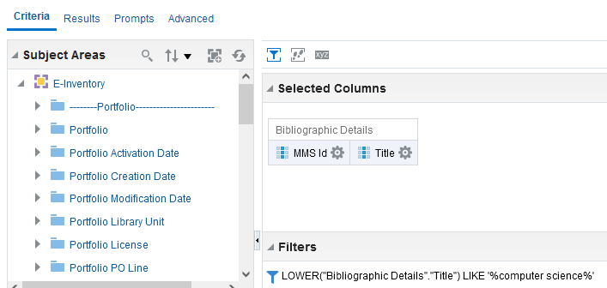
Create the link in an analytics report
Here is a report which includes the MMS ID

Slide 11
Create the link in an analytics report
We will now append the green text to before the MMSID and the blue text to after the MMS ID.
https://exldeveu00.primo.exlibrisgroup.com/discovery/search?query=any,contains,99201211000121&tab=LibraryCatalog&search_scope=MyInstitution&vid=EXLDEV1_INST:Alma&lang=en&offset=0

Slide 12
Create the link in an analytics report
Do “edit formula” on the MMSID
Change the header to be “URL” (or whatever text you want)
Change
"Bibliographic Details"."MMS Id"
to
'https://exldeveu00.primo.exlibrisgroup.com/discovery/search?query=any,contains,' || "Bibliographic Details"."MMS Id" || '&tab=LibraryCatalog&search_scope=MyInstitution&vid=EXLDEV1_INST:Alma&lang=en&offset=0'

Slide 13
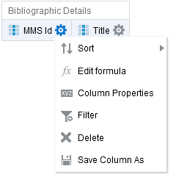
Create the link in an analytics report
Do “edit formula” on the MMS ID

Slide 14
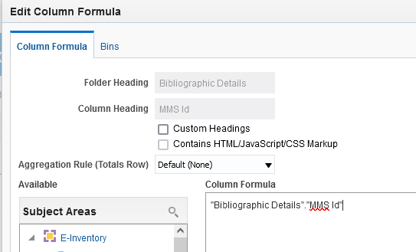
Create the link in an analytics report
We will change this

Slide 15
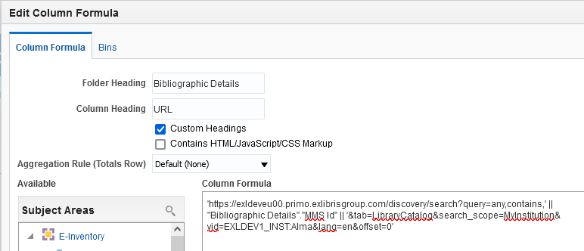
Create the link in an analytics report
Here is the new field

Slide 16
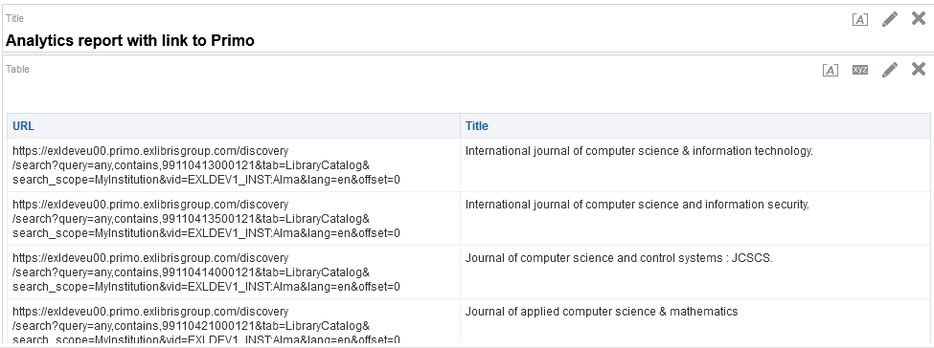
Create the link in an analytics report
In the “results” tab see that you have the URL for each record

Slide 17

Create a textual hyperlink for Excel

Slide 18
Create a textual hyperlink for Excel
We can make a hyperlink for the export to Excel, and have a specific text for the hyperlink.
We will do the same exact steps as done previously, but we will add the text in red below to the beginning and end:
'=HYPERLINK("' || 'https://exldeveu00.primo.exlibrisgroup.com/discovery/search?query=any,contains,' || "Bibliographic Details"."MMS Id" || '&tab=LibraryCatalog&search_scope=MyInstitution&vid=EXLDEV1_INST:Alma&lang=en&offset=0' || '","Link to Primo")'

Slide 19
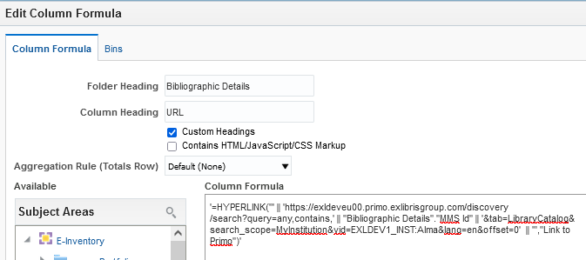
Create a textual hyperlink for Excel
Now we have this in the “edit formula”:

Slide 20
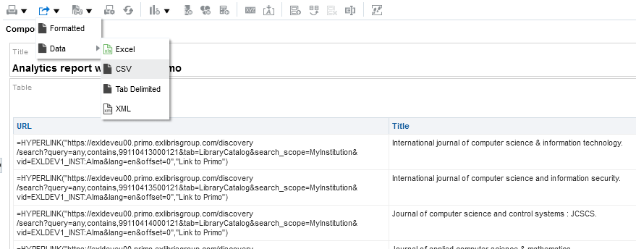
Create a textual hyperlink for Excel
Export to csv and open in Excel

Slide 21
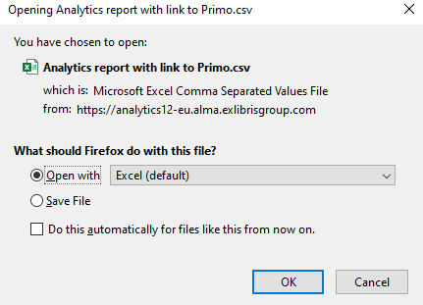
Create a textual hyperlink for Excel
Export to csv and open in Excel

Slide 22
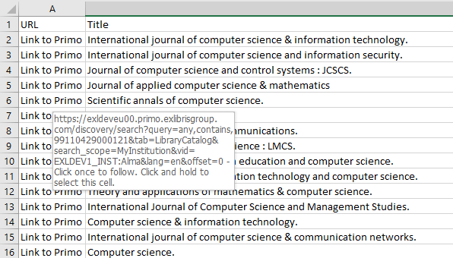
Create a textual hyperlink for Excel
Click the link to Primo

Slide 23
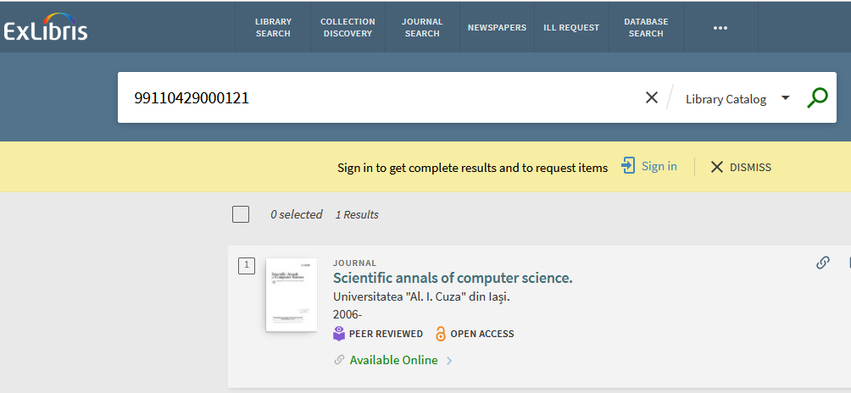
Create a textual hyperlink for Excel
The record opens in Primo

Slide 24
xxx@exlibrisgroup.com

